Slide 1
CSE225: Data Structure and Algorithms Types of Algorithms

Slide 2
Algorithm
An Algorithm is any well-defined computational procedure that takes some values or set of values as input and produces some values or set of values as output.
An Algorithm is a well defined list of steps to solve a particular problem.

Slide 3
NOTION OF ALGORITHM
problem
algorithm
“computer”
input
output
Algorithmic solution

Slide 4
A short list of categories
Algorithm types we will consider include:
Simple recursive algorithms
Backtracking algorithms
Divide and conquer algorithms
Dynamic programming algorithms
Greedy algorithms
Branch and bound algorithms
Brute force algorithms
Randomized algorithms

Slide 5
SOME WELL-KNOWN COMPUTATIONAL PROBLEMS
Sorting
Searching
Shortest paths in a graph
Minimum spanning tree
Primality testing
Traveling salesman problem
Knapsack problem
Chess
Towers of Hanoi
Program termination

Slide 6
Algorithms
Properties of a good Algorithm:
• Input from a specified set,
• Output from a specified set (solution),
• Effectiveness of each calculation step and
• Finiteness of the number of calculation steps,
• Correctness of output for every possible input

Slide 7
Types of Algorithms

Slide 8
Algorithm classification
Algorithms that use a similar problem-solving approach can be grouped together
This classification scheme is neither exhaustive nor disjoint
The purpose is not to be able to classify an algorithm as one type or another, but to highlight the various ways in which a problem can be attacked

Slide 9
A short list of categories
Algorithm types we will consider include:
Simple recursive algorithms
Backtracking algorithms
Divide and conquer algorithms
Dynamic programming algorithms
Greedy algorithms
Branch and bound algorithms
Brute force algorithms
Randomized algorithms

Slide 10
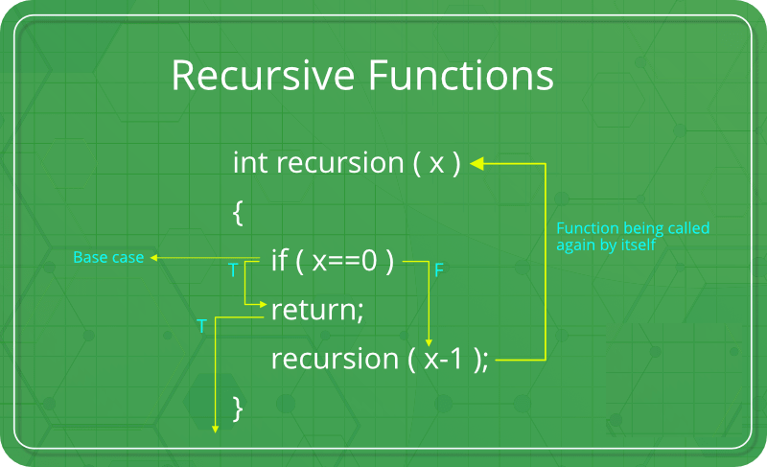
What is Recursion?
The process in which a function calls itself directly or indirectly is called recursion and the corresponding function is called as recursive function. Using recursive algorithm, certain problems can be solved quite easily. Examples of such problems are Towers of Hanoi (TOH), Inorder/Preorder/ Postorder Tree Traversals, DFS of Graph, etc.

Slide 11
Simple recursive algorithms I
A simple recursive algorithm:
Solves the base cases directly
Recurs with a simpler subproblem
Does some extra work to convert the solution to the simpler subproblem into a solution to the given problem
“simple” because several of the other algorithm types are inherently recursive

Slide 12
Finding the factorial of 3
fact(1)
1
fact(2)
fact(2)
fact(2)
2
fact(3)
fact(3)
fact(3)
fact(3)
fact(3)
6
main()
main()
main()
main()
main()
main()
Time 2:
Push: fact(3)
Time 3:
Push: fact(2)
Time 4:
Push: fact(1)
Time 5:
Pop: fact(1)
returns 1.
Time 6:
Pop: fact(2)
returns 2.
Time 7:
Pop: fact(3)
returns 6.
Inside findFactorial(3):
if (number <= 1) return 1;
else return (3 * factorial (2));
Inside findFactorial(2):
if (number <= 1) return 1;
else return (2 * factorial (1));
Inside findFactorial(1):
if (number <= 1) return 1;
else return (1 * factorial (0));

Slide 13
Complexity of Recursive Algorithm
int factorial(int n) {
if (n == 1)
return 1;
else
return n * factorial(n-1);
}
T(1) = 1
T(2) = T(1) + 1 = 2
T(3) = T(2) + 1 = 3
T(4) = T(3) + 1 = 4
...
T(n) = n
So in general this algorithm will require n units of work to complete (i.e. T(n) = n).
So O(n)

Slide 14
Backtracking Algorithm
Backtracking is a general algorithm for finding all (or some) solutions to some computational problems, notably constraint satisfaction problems, that incrementally builds candidates to the solutions, and abandons a candidate ("backtracks") as soon as it determines that the candidate cannot possibly be completed to a valid solution.[1]
The classic textbook example of the use of backtracking is the eight queens puzzle, that asks for all arrangements of eight chess queens on a standard chessboard so that no queen attacks any other.

Slide 15
Backtracking algorithms
Backtracking algorithms are based on a depth-first recursive search
A backtracking algorithm:
Tests to see if a solution has been found, and if so, returns it; otherwise
For each choice that can be made at this point,
Make that choice
Recur
If the recursion returns a solution, return it
If no choices remain, return failure

Slide 16
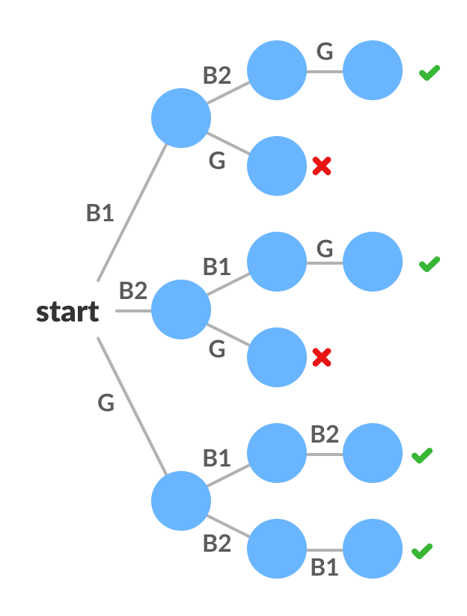
Example
If there are three students two boys and a girl and there are three chairs. We have to arrange them in those three chairs in how many ways we can arrange there are three number of students are three so we can arrange them in 3 factorial ways. That is six ways.

Slide 17
Complexity of Backtracking Algorithm
Backtracking algo:
n-queen problem:O(n!)
graph coloring problem:O(nm^n)//where n=no. of vertex,m=no. of color used
hamilton cycle:O(N!)
WordBreak and StringSegment:O(2^N)
subset sum problem:O(nW)

Slide 18
Divide and Conquer
A divide and conquer algorithm consists of two parts:
Divide the problem into smaller subproblems of the same type, and solve these subproblems recursively
Combine the solutions to the subproblems into a solution to the original problem
Traditionally, an algorithm is only called divide and conquer if it contains two or more recursive calls

Slide 19
Divide and conquer algorithm
divide and conquer is an algorithm design paradigm. A divide-and-conquer algorithm recursively breaks down a problem into two or more sub-problems of the same or related type, until these become simple enough to be solved directly. The solutions to the sub-problems are then combined to give a solution to the original problem.
The divide-and-conquer technique is the basis of efficient algorithms for many problems, such as sorting (e.g., quicksort, merge sort), multiplying large numbers (e.g., the Karatsuba algorithm), finding the closest pair of points, syntactic analysis (e.g., top-down parsers), and computing the discrete Fourier transform (FFT).

Slide 20
Examples
Quicksort:
Partition the array into two parts, and quicksort each
of the parts
No additional work is required to combine the two sorted parts
Mergesort:
Cut the array in half, and mergesort each half
Combine the two sorted arrays into a single sorted array by merging them

Slide 21
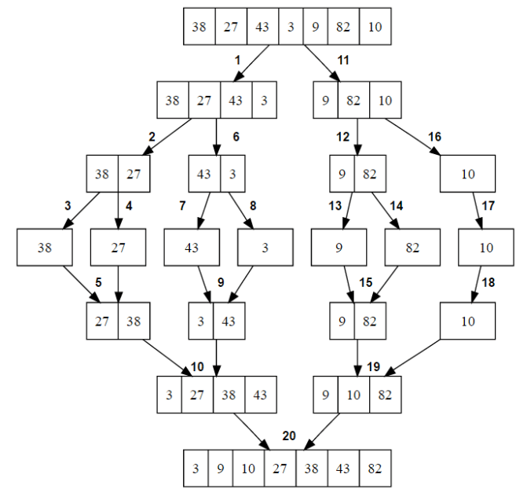
Merge Sort Example
Complexity of Merge sort: O(n*log n)

Slide 22
Dynamic programming algorithms
A dynamic programming algorithm remembers past results and uses them to find new results
Dynamic programming is generally used for optimization problems
Multiple solutions exist, need to find the “best” one
Requires “optimal substructure” and “overlapping subproblems”
Optimal substructure: Optimal solution contains optimal solutions to subproblems
Overlapping subproblems: Solutions to subproblems can be stored and reused in a bottom-up fashion
This differs from Divide and Conquer, where subproblems generally need not overlap

Slide 23
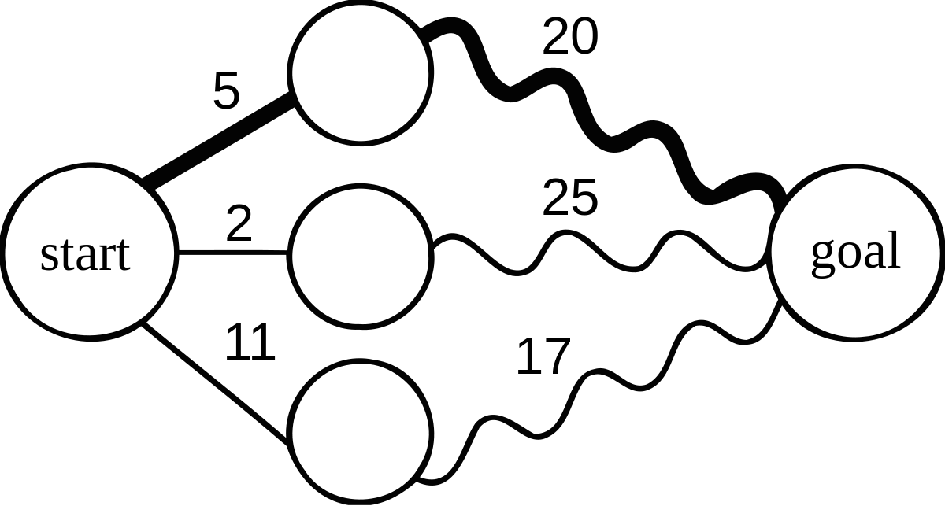
if a problem can be solved optimally by breaking it into sub-problems and then recursively finding the optimal solutions to the sub-problems, then it is said to have optimal substructure

Slide 24
Complexity of Dynamic Programming
In Dynamic programming problems, Time Complexity is the number of unique states/subproblems * time taken per state.
In this problem, for a given n, there are n unique states/subproblems. For convenience, each state is said to be solved in a constant time. Hence the time complexity is O(n * 1).
Hence the time complexity is O(n ) or linear.

Slide 25
Greedy algorithms
An optimization problem is one in which you want to find, not just a solution, but the best solution
A “greedy algorithm” sometimes works well for optimization problems
A greedy algorithm works in phases: At each phase:
You take the best you can get right now, without regard for future consequences
You hope that by choosing a local optimum at each
step, you will end up at a global optimum

Slide 26
Greedy algorithm
A greedy algorithm is any algorithm that follows the problem-solving heuristic of making the locally optimal choice at each stage.[1] In many problems, a greedy strategy does not usually produce an optimal solution, but nonetheless, a greedy heuristic may yield locally optimal solutions that approximate a globally optimal solution in a reasonable amount of time.
Example: Huffman Coding, TSP

Slide 27
For example, a greedy strategy for the travelling salesman problem (which is of a high computational complexity) is the following heuristic: "At each step of the journey, visit the nearest unvisited city." This heuristic does not intend to find a best solution, but it terminates in a reasonable number of steps; finding an optimal solution to such a complex problem typically requires unreasonably many steps. In mathematical optimization, greedy algorithms optimally solve combinatorial problems having the properties of matroids, and give constant-factor approximations to optimization problems with submodular structure.

Slide 28
Traveling salesperson problemor TSP
The travelling salesman problem asks the following question: "Given a list of cities and the distances between each pair of cities, what is the shortest possible route that visits each city exactly once and returns to the origin city?" It is an NP-hard problem in combinatorial optimization, important in theoretical computer science and operations research.

Slide 29
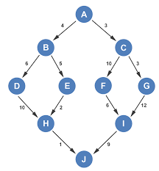

Slide 30
Complexity of Greedy Algorithm
complexity is O(nlogn).

Slide 31
Branch and bound algorithm
Branch and bound is an algorithm design paradigm which is generally used for solving combinatorial optimization problems. These problems are typically exponential in terms of time complexity and may require exploring all possible permutations in worst case. The Branch and Bound Algorithm technique solves these problems relatively quickly.

Slide 32
Example branch and bound algorithm
Travelling salesman problem: A salesman has to visit each of n cities (at least) once each, and wants to minimize total distance travelled
Consider the root problem to be the problem of finding the shortest route through a set of cities visiting each city once
Split the node into two child problems:
Shortest route visiting city A first
Shortest route not visiting city A first
Continue subdividing similarly as the tree grows

Slide 33
Branch and bound algorithms
Branch and bound algorithms are generally used for optimization problems
As the algorithm progresses, a tree of subproblems is formed
The original problem is considered the “root problem”
A method is used to construct an upper and lower bound for a
given problem
At each node, apply the bounding methods
If the bounds match, it is deemed a feasible solution to that particular subproblem
If bounds do not match, partition the problem represented by
that node, and make the two subproblems into children nodes
Continue, using the best known feasible solution to trim sections of the tree, until all nodes have been solved or trimmed

Slide 34
Printing Items in 0/1 Knapsack
Given weights and values of n items, put these items in a knapsack of capacity W to get the maximum total value in the knapsack. In other words, given two integer arrays val[0..n-1] and wt[0..n-1] which represent values and weights associated with n items respectively. Also given an integer W which represents knapsack capacity, find out the items such that sum of the weights of those items of given subset is smaller than or equal to W. You cannot break an item, either pick the complete item, or don’t pick it (0-1 property).

Slide 35
Input : val[] = {60, 100, 120};
wt[] = {10, 20, 30};
W = 50;
Output : 220 //maximum value that can be obtained
30 20 //weights 20 and 30 are included.
Input : val[] = {40, 100, 50, 60};
wt[] = {20, 10, 40, 30};
W = 60;
Output : 200
30 20 10

Slide 36
Complexity of 0-1 knapsack problem
O (nC) where n is number of elements in knapsack and C is a capacity of knapsack.

Slide 37
Brute force algorithm
A brute force algorithm simply tries all
possibilities until a satisfactory solution is found
Such an algorithm can be:
Optimizing: Find the best solution. This may require finding all solutions, or if a value for the best solution is known, it may stop when any best solution is found
Example: Finding the best path for a travelling salesman
Satisficing: Stop as soon as a solution is found that is good enough
Example: Finding a travelling salesman path that is within 10% of optimal

Slide 38
Traveling salesman problem (TSP
A classic example in computer science is the traveling salesman problem (TSP). Suppose a salesman needs to visit 10 cities across the country. How does one determine the order in which those cities should be visited such that the total distance traveled is minimized?
The brute force solution is simply to calculate the total distance for every possible route and then select the shortest one. This is not particularly efficient because it is possible to eliminate many possible routes through clever algorithms
The time complexity of brute force is O(mn), which is sometimes written as O(n*m) .

Slide 39
Randomized algorithms
A randomized algorithm uses a random number at least once during the computation to make a decision
Example: In Quicksort, using a random number to choose a pivot
Example: Trying to factor a large prime by choosing random numbers as possible divisors

Slide 40
Crossing the Rivers
Woman, G1 G2
Man, B1 B2
Police, Thieves
1. Boat can carry only 2 persons
2. Woman, Man and Police can ride the boat
3. a. If Woman absent Men killed woman’s Girls
b. If Man absent then Woman killed man’s boys.
c. If Police absent then Thieves killed everybody.

